Slide 1
Architectural Design

Slide 2
Architectural design
1st stage in software design process
concerned with:
understanding how a software system should be organized
designing the overall structure of that system.
It is the critical link between design and requirements engineering
as it identifies the main structural components in a system and the relationships between them.
output of this process is an architectural model that describes how the system is organized as a set of communicating components.

Slide 3
Agility and architecture
It is generally accepted that an early stage of agile processes is to design an overall systems architecture.
Refactoring is easy BUT refactoring the system architecture is usually expensive because a lot of components have to be changed to adapt to the architectural changes.

Slide 4
The architecture of an ATM Machine
Validate card
Validate via Finger print sensor
Select options
Collect cash
Send command to database
perform the transaction
View balance

Slide 5
The architecture of a packing robot control system
Pack different kind of objects.
Classify it to a type
Package accordingly
And put on to another conveyor for shipment

Slide 6
RE & Design process overlapping
Practically the requirement specification process is overlapped with architectural design procedure
It is impossible that the specification does not includes design information
You need to identify the main architectural components as these reflects the high level features of the system.
so the RE process must show a sort of abstract system arch showing where you associate subsystems .
You may use this decomposition to discuss & finetune requirements with stakeholders

Slide 7
Architectural abstraction
You can design software architecture at two levels of abstraction:
Architecture in the small:
concerned with the architecture of individual programs.
Depicts how an individual program is decomposed into components.
Architecture in the large:
concerned with the architecture of complex enterprise systems
that include other systems, programs, and program components.
These enterprise systems are distributed over different computers, which may be owned and managed by different companies.

Slide 8
Why Software Architecture is important?
Non – functional requirements are applied to the system as a whole.
System architecture affects the non-functional requirements of the system.
Like, robustness, performance, maintainability etc.

Slide 9
Advantages of explicit architecture
Stakeholder communication
High level presentation of a system.
Architecture may be used as a focus of discussion by system stakeholders.
System analysis
Means that analysis of whether the system can meet its non-functional requirements is possible.
Large-scale reuse
As architecture is the compact manageable details of system organization & its interoperations. So,
Same system architecture is often used for similar applications.
The architecture may be reusable across a range of systems.

Slide 10
Architectural representations
Often modeled as informal block diagrams showing entities and relationships.
Components are represented as Box
Sub components are represented as nested boxes.
Arrows depicts the data and control signals flowing from components.

Slide 11
Box and line diagrams
Very abstract
They do not show:
the nature of component relationships
the externally visible properties of the sub-systems (fault tolerance, shared resource usage etc.) .
However, useful for communication with stakeholders and for project planning.

Slide 12
Ways to use the architectural models
As a way of facilitating discussion about the system design
A high-level architectural view of a system
Useful for project planning with system stakeholders
Not cluttered with detail.
Easily relatable
System understanding without considering implementation details.
Since it identifies the key components, so tasks planning & assignment will become easy.
As a way of documenting an architecture that has been designed
The aim here is to produce a complete system model that shows the different components in a system, their interfaces and their connections.
System evolution & understanding becomes easy

Slide 13
architectural models’ representation
For documenting architectural details, better to use an ADL(Architecture Description Language).
As they are recognized globally
Some ADLs are : UML, ArchiMate
Drawbacks;
Time consuming
Expensive solution

Slide 14
Architectural design decisions

Slide 15
Architectural design decisions
Architectural design is a creative process to develop a system via fulfilling FRs & NFRs.
No formulaic design process
Depends upon:
System type
Background
Experience of system architect
Requirements
So it’s a series of decisions to made, not a sequence of activities to be performed.
However, a number of common decisions span all design processes and these decisions affect the non-functional characteristics of the system.

Slide 16
Architectural design decisions by system architect

Slide 17
Architecture reuse
Systems in the same domain often have similar architectures that reflect domain concepts.
Application are built around a core architecture with variants that satisfy particular customer requirements.
An IMS must have basic CRUD features. Extra features could be added as per customer requirements.
So, decide carefully to which extent architecture can be reused from a similar system.
The architecture of a system may be designed around one of more architectural patterns or ‘styles’.
An architectural pattern -> description of system organization.(client-server org.)
Selecting a pattern depends upon its weaknesses & strengths. We will discuss it later in detail.
Pattern selection depends on NFRs as it has a direct impact of software architecture.

Slide 18
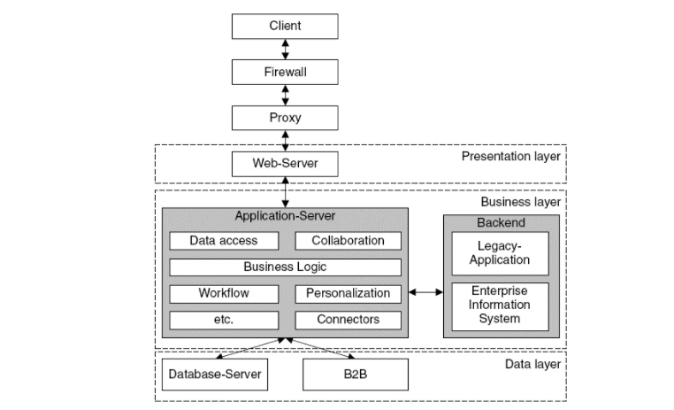
Architecture and system characteristics what to do if following NFRs are critical?
Performance
Localize critical operations within a small no. of components deployed on same system
Don’t use distributed systems (creates delay in Message passing)
Use large rather than fine-grain components to minimize communications.
Effectively use multiple processors in your system for task scheduling.
Security
Use a layered architecture with critical assets in the inner layers.
E.g., multi tier architectures

Slide 19
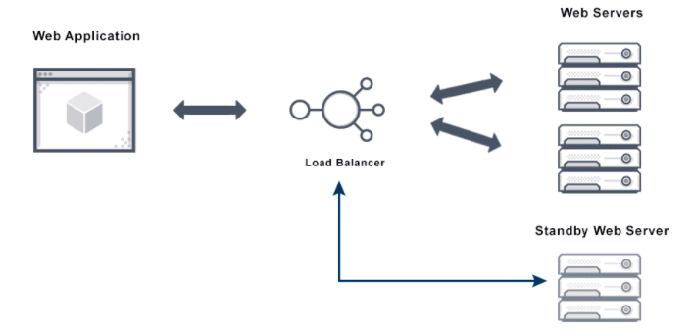
Architecture and system characteristics what to do if following NFRs are critical?
Safety
Localize safety-critical features in a small number of sub-systems.
Reduces the cost of safety validations
and it has a separate shutdown system that safely shuts down in case of any failure.
Availability
Architecture should be designed to Include redundant components
So its possible to replace/update component in case of fault occurrence.
E.ge., fault tolerant system architectures

Slide 20
Architecture and system characteristics what to do if following NFRs are critical?
Maintainability
Design using self grained components that can be changed.
Shared data structures is avoided (e.g., static variables are shared between multiple instances)

Slide 21
Conflicting critical requirements ?
Performance improve with lesser no. of components and maintainability improves with more subcomponents.
Security is the critical req. for almost all applications these days.
Solution:
Compromise over less critical requirement
or use multiple architectural styles for separate parts of systems.

Slide 22
Architectural views

Slide 23
Architectural views
What views or perspectives are useful when designing and documenting a system’s architecture?
What notations should be used for describing architectural models?
Impossible to show all perspectives from one diagram.
So presenting multiple views to show different perspectives like:
how system is decomposed,
how runtime processes interact,
how components are distributed across network etc.

Slide 24
Architectural views

Slide 25
4 + 1 view model of software architecture (Krutchen, 1995)
Proposed 4 basic views linked via different use cases:
A logical view:
shows the key abstractions in the system as objects or object classes.
Relate system requirements to entities
A process view:
shows how system interacts with interacting processes at run-time.
Useful for making judgments related to NFRs like availability/performance.

Slide 26
4 + 1 view model of software architecture (Krutchen, 1995)
A development view:
shows breakdown of software assigned to a development team/developer.
Useful for project managers & developers.
A physical view:
Shows how the system hardware and software components are distributed across the processors in the system.
Useful for system engineers.
(Hofmeister et al.,2000) just added conceptual view to this 4 + 1 model.
Conceptual view: (almost always developed in design process)
Abstract view of high level req. to identify product line arch for future reuse.
Decide which components could be reused for any other application

Slide 27
Representing architectural views
Use UML for architecture representation?
Some people argue that the Unified Modeling Language (UML) is an appropriate notation for describing and documenting system architectures
But UML is designed for object oriented systems, that will make it more implementation oriented rather than being abstract. Moreover, it’ll increase time.
But UML is of more value when you describe system in detail.
Architectural description languages (ADLs) have been developed but are not widely used because they are too domain specific. They enforce rules & guidelines for different architectures.
Better to go with Informal box /UMLs diagrams for architecture design .

